Slide 1
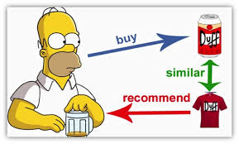
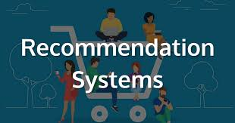
ElementHome
A J-component Report for Software Engineering

Slide 2


Team Infographics
Aryaman Mishra (19BCE1027)
Eshan Das(19BCE1575)

Slide 3
Problem Statement
Millennials and people who are bored at their working jobs usually would ask their colleagues for any type of suggestion which would keep them engaged for some time but usually the question is to no avail or they get directed to watch/play something which wasn’t common to their taste. People usually turn a blind eye to find out necessary information because the information they want is scattered all over the world wide of web.
Netflix has been rolling out with new titles over the past few years and people have been coercing themselves to sit through hours of episodes watching a series or film they don’t necessarily like but suffice so as to keep themselves engaged.
This practice of wasting time and burning our eyes has to come to stop as people are being forced to watch just to claim that they have watched the latest movie and series which dissolves a person’s own likings and identity. In the case of games, we are recommended to play this newly-released title, we buy them from Steam Service, download that game but when we run our system either gets heated up to oblivion or we are shown the Blue Screen of Death-meaning that the application just overclocked the system and vastly decreased it’s life expectancy.

Slide 4
Description about ElementHome
Our app provides a first of it’s kind service where it would provide for all sorts of entertainment media and would even recommend genuine titles by taking a small multiple choice quiz so people get to share their viewing/playing experiences and gain information which caters for their liking and stop wasting time watching something that is not to their liking.
A person would get to compare their hardware to the recommended benchmark so that they would not waste their money on an application which their setup won’t run.

Slide 5

Identification of modules:
Module 1:User Authentication and Login
Module 2:Selecting Preferred Multimedia Type
Module 3-Recommendation and Searching
Module 4-Viewing a title’s information
Module 5-User Participation
Module 6-Survey

Slide 6
Modules
Module 1:User Authentication and Login
First and foremost, we have user validation which offers a sliding menu which transitions from sign-up page to login page without having to load another webpage. Our signing-up menu asks user for their name, Contact number, E-mail ID, and Country and Password which is to be re-entered to avoid confusion.
Our Login Page would then ask registered users to enter their E-Mail Address along with the entered password to view the index page of our website.

Slide 7
Modules
Module 2:Selecting Preferred Multimedia Type
To avoid confusions and prevent database clashing, we will be providing 3 options to our users to choose between Movies, Games and Television Shows on our index page. This is to adjust adaptions of multiple titles over different mediums.
For example:-The Terminator Franchise has 6 Hollywood Flicks(1982-2020),multiple games belonging to different genres and the TV Show-The Terminator: Sarah, Connor Chronicles(2009).Each option would redirect user to explore between 3 different sets of databases-Movies(People behind the scenes and Reviews),TV Shows(Air Date and Number of seasons) and Games(hardware requirement and genre).

Slide 8
Modules
Module 3-Recommendation and Searching
The user may want to try something new so we will have them fill out a form consisting of which multimedia type are they looking for, which genre would the user prefer. The user will be able to decide from reviews for movies and shows.
He/she can also sort through games depending on their hardware requirements(RAM,CPU and Graphic Card).If the user wants to know the details regarding a single title, he/she can search for it in the search bar by way of either name or unique ID Number. User can also view the database to dive into the depths of our libraries,

Slide 9
Modules
Module 4-Viewing a title’s information
The person will click upon the searched results and will view details regarding that title. It is important to note that games will have separate set of information(producer, developer, engine, platforms, composers) while Movies and TV Shows will have generally the same dataset(with exception of Channels, format, number of episodes and seasons).
The user will also be provided links where they can be brought from or redirected to a payment portal to pay directly from a validated source. The information page also consists of an upvote and downvote option where the user can get the feedback of the general public.

Slide 10

Modules
Module 5-User Participation
The user can give a comment or provide an entire review for other people who will visit the title’s page. This will be done via upvote-downvote and comment box system.

Slide 11

Modules
Module 6-Survey
At the end of the session, whenever a user is going to log off, a pop-up survey will be visible where we can ask about the session or whether they faced any issues from the server-side and whether they were satisfied with our recommendation.
They will be able to suggest and complaint so the website can eventually be more sustainable and free of unnecessary glitches.

Slide 12
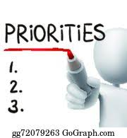
Prioritization
Creation of required databases
Coding which requires information of XAMPP,AJAX,PHP and SQLite.
Linking and Designing.
Converting Localhost to native Android/IoS

Slide 13

Software Requirements Specification
Table of Contents
Table of Contents...........................................................................................................................1
Revision History.............................................................................................................................4
1. Introduction............................................................................................................................13
1.1 Purpose........................................................................................................................................... 13
1.2 Document Conventions.................................................................................................................. 13
1.3 Intended Audience and Reading Suggestions................................................................................ 14
1.4 Product Scope ................................................................................................................................ 14
1.5 References...................................................................................................................................... 14
2.
Overall Description................................................................................................................14
2.1 Product Perspective........................................................................................................................ 14
2.2 Product Functions .......................................................................................................................... 14
2.3 User Classes and Characteristics ................................................................................................... 15
2.4 Operating Environment.................................................................................................................. 15
2.5 Design and Implementation Constraints ........................................................................................ 15
2.6 User Documentation ...................................................................................................................... 15
2.7 Assumptions and Dependencies .................................................................................................... 16
3. External Interface Requirements .........................................................................................16
3.1 User Interfaces ............................................................................................................................... 16
3.2 Hardware Interfaces ....................................................................................................................... 16
3.3 Software Interfaces ........................................................................................................................ 16
3.4 Communications Interfaces ........................................................................................................... 16
4. System Features .....................................................................................................................17
4.1 System Feature 1............................................................................................................................ 17
4.2 System Feature 2 (and so on)..........................................................Error! Bookmark not defined.
5. Other Nonfunctional Requirements.....................................................................................18
5.1 Performance Requirements ............................................................................................................ 18
5.2 Safety Requirements ...................................................................................................................... 18
5.3 Security Requirements ................................................................................................................... 18
5.4 Software Quality Attributes ........................................................................................................... 19
5.5 Business Rules ............................................................................................................................... 19
6 Stakeholderrequirements………………………………………………………………...........
7. Team size………………………………………………………………………………………..
report /flow diagram/gantt chart…………………………………………………………………
final deliverable must include…………………………………………………………………..
10. other requirements……………………………………………………………………………...

Slide 14



11.use case diagram………………………………………………………………………………...
Appendix A: Glossary......................................................................Error! Bookmark not defined.
Appendix B: Analysis Models .........................................................Error! Bookmark not defined.
Appendix C: To Be Determined List..............................................Error! Bookmark not defined.
Revision History
Name | Date | Reason For Changes | Version
Srs_1.1 | 1/08/20 | More modules are added | 1.1
Srs_1.2 | 18/08/20 | More functional requirements and tracebility matrix,report/gantt chart/flow diagram | 1.2
Srs_1.0 | 1/07/20 | Srs | 1.0
1.
Version 1.0 approved
1. Introduction
1. Purpose
Movies, Series and Games recommendation system, is a software to look after the recommendation of movies, series and games to its users based on their friend’s recommendation. The app would give hands-on information(offline information which is updated from time-to-time by the developers in form of updates) and would be supported by databases containing information over 1000 entries in each section.
1. Document Conventions

Slide 15
Headings with font size are typed out in “Times”
“18”.Bold style
The body for all sections is
written in “Arial” with font size “11”.
Italics style
Fonts :
Intended Audience and Reading Suggestions
As this software is developed in such a way that can be used by any kind of people who generally use internet, the end
users are mainly the people who uses the internet browsers and watching entertainment shows and gaming.
Product Scope
The purpose of the Movies, Series and Games recommendation system is to ease to access the internet data’s anduser-friendly manner for the customers. The system is based on a relational database from medias, gaming’s and the entertainment shows. So the scope of this application is very widely distributed.
References
https://towardsdatascience.com/the-4-recommendation-engines-that-can-predict-your-movie- tastes-109dc4e10c52
https://www.manipalprolearn.com/blog/10-recommendation-engines-10-popular-brands-need- have
2. Overall Description
Product Perspective I/p-task-o/p
The objective of our project is to develop a software which will recommend the movies, series and games to its users based on their friend’s recommendation. We plan to create an app which runs on Android O which lets the users to create an account and a profile and tell others what film have they watched, which TV Showsare they watching or planned to watch and which Game have they been playing. The app would give hands-on information(offline information which is updated from time-to-time by the developers in form of updates) and would be supported by databases containing information over 1000 entries in each section.
This would give people a topic common between them and would then take recommending
multimedia to a digital level.
Product Functions

Slide 16


It lets you to know what movie, game your friends have been watching and playing as
recommendations
This lets you with the information’s(offline information’s which are getting updated
Information provided are of 3 categories include creators,availability,overview details and reception from
various multimedia-related resources.
3. User Classes and Characteristics
As it is general software developed it can be used by any kind of people who generally use internet. The main characteristics is that the system needs to be updated every time do the information’s provide are latest and finest one.
Particulars | Client System | Server System
Operating System | Windows/Linux/Android/iOS | Linux
Processor | Intel or AMD | Intel or AMD
Hard Disk | 1 GB | 1 TB
RAM | 256 MB | 8 GB
4. Operating Environment
Operating environment for the Movies, Series and Games recommendation systemis as listed below.
2.5 Design and Implementation Constraints
Customers must give the details appropriately and also create a user credentials, so that the details passed and cross
checked.
As this could be a bigger change in android app as it can include creators, availability,overview details and reception from wide range of multimedia’s.
Constraints
The applicants require a computer to submit their information.
Although the security is given high importance, there is always a chance of intrusion in the web world which requires
constant monitoring.
The user has to be careful while submitting the information. Much care is required.

Slide 17

2.6 User Documentation
a.https://towardsdatascience.com/the-4-recommendation-engines-that-can-predict-your- movie-tastes- 109dc4e10c52
2.7 Assumptions and Dependencies
As this project was developed for people who uses internet for entertainment purpose, so people who use the online platform for gaming, series and movie watching purpose can utilize this app appropriately.
The Applicants and Administrator must have basic knowledge of computers and English Language.
The applicants may be required to scan the documents and send.
Each User must have a UserID and password
There must be an Administrator
Internet connection is a must
Proper browsers should be installed in the user’s system
3. External Interface Requirements
1. User Interfaces
2.
a^{H}. ªU^{rd}se^{w}sªj^{r}a^{e}va^{I}(^{n}le^{t}g^{er}a^{f}cªy^{c}p^{e}r^{s}ogramming language)
ab. .Opkeortalitnin(ngeswysltaenmg:wuaingdeowinst,roLdinuucxe,minac2O0S17)
b. Hard disk :128Gb
c. RAM: 8Gb
3.3 Software Interfaces
Windows,Linux,macOS

Slide 18



3.4 Communications Interfaces
Window, and supported browsers and Native Android.
4. System Features
1. System Feature 1
Description and Priority
The objective of our project is to develop a software which will recommend the movies, series and games to its users based on their friend’s recommendation. We plan to create an app which runs on Android O which lets the users to create an account and a profile and tell others what film have they watched, which TV Shows are they watching or planned to watch and which Game have they been playing.The app would give hands-on information (offline information which is updated from time-to-time by the developers in form of updates) and would be supported by databases containing information over 1000 entries in each section.
Stimulus/Response Sequences
Input the details of the users: like the user credentials and the get the inputted the data’s in case of shows, series watched
Functional Requirements
REQ1: | System that can store all textual details of the customer
REQ2: | the files uploaded by the customer such as user credentials, the movies,series and games viewed by there friends.
REQ3: | System that can generate the recommendations for the series, movies and games
5. Other Nonfunctional Requirements
1. Performance Requirements
This project enables the user to view the recommended movies, series and games of their friends who have watched and played.

Slide 19

Safety Requirements
Due to any catastrophic problem the database got damaged then by using the backup method and recover the data’s,so there will be additional database storage in hard-disk.
Security Requirements
Security system must be efficient like other application as this project stores sensitive data’s and a large database.
Software Quality Attributes
Portability: web services used so it can be ported.
Reliability : as the software is updated regularly, it is more reliable
4. Business Rules
As the information’s are not completely shared so it’s safer and more reliable for the users for
getting more useful data even without wasting time on searching.
6. Other Requirements
This project can be used from any corners of the world as it is registered under a web services platform, as well as for running it there need a good storage.
Appendix A: Glossary
Definitions, Acronyms and Abbreviation:
SRS: Software Requirement Specification
Client/User: The entity who will be using the passport registration
Server: A system that runs in Linux that monitors the passport registration
RAM: Random Access Memory
PHP: Hypertext Preprocessor
MySQL: A relational database management system
HTTP: Hyper Text Transfer Protocol
PDF: Portable Document Format
Username: Unique name given to each account of digital library
Password: Unique word given to each user as a secret code
HTM, JSP, JavaScript, Java, XML, AJAX

Slide 20

2. Version 1.1 approved
1. | NAME OF THE PROJECT | SERIES, MOVIES AND GAMES RECOMMENDATION SYSTEM
2. | OBJECTIVE/VISION | The objective of our project is to develop a software which will recommend the movies, series and games to its users based on their friend’s recommendation. We plan to create an app which runs on Android O which lets the users to create an account and a profile and tell others what film have they watched, which TV Shows are they watching or planned to watch and which Game have they been playing. The app would give hands-on information (offline information which is updated from time-to-time by the developers in form of updates) and would be supported by databases containing information over 1000 entries in each section.This would give people a topic common between them and would then take recommending multimedia to a digital level.
3. | USERS OF THE SYSTEM | Anyone wanting hands on information about Movies, games and series. people providing the services
4. | FUNCTIONAL REQUIREMENTS | FR1. Sessions are used so that the person can be logged in for as much time as he wants. To log out, logout buttons are there on every page. FR2. On successful signup, the user receives a welcome email on the account he has registered on. FR3. The minimum length of the password is set as 6 characters and every field is mandatory. FR4. On giving a null value to any field a prompt is

Slide 21
 |  | generated FR5. The user can view the services and, in any case, if he doesn’t like something, he/she can logout. FR6. The user can select more than one service at any time according to his need FR7. Also, the user will be allowed to follow only those accounts to get recommendation whose accounts he/she likes. FR8. The user will also be asked to give his/her recommendation of series, movies and games as soon as he completes watching them or playing them, FR9. At the end when he wishes to exit the app, he would be asked to give his feedback and rate the application.
5. | NON-FUNCTIONAL REQUIREMENTS | NFR1. SECURITY: Account details will be protected in this legacy Server The recommendation of the user will be encrypted in such a
 |  | Way that they are not seen by the management system.
 |  | Each user using the application will have to make an
 |  | account on this application and would be given a separate
 |  | login id. All the modifications made by the users will be
 |  | synchronised with the database for instant reflection.
 |  | NFR2. PERFORMANCE:
 |  | The product will be based on the local server and it will
 |  | take an initial loading time. The performance would
 |  | depend on hardware component of both parties. The
 |  | system will have different entries in database for users and
 |  | employees.
 |  | NFR3. SAFETY REQUIREMENTS:
 |  | All the vulnerabilities in the system should be tested and
 |  | filled prior to serving it to the users. The servers should be
 |  | devoid of black or Gray hat hackers. the data should be
 |  | secured and users data is always expected to be protected
 |  | by admins. These maintains security and privacy.
 |  | NFR4.24*7 Availability of website and flexible service-
 |  | based architecture will be highly desirable for future
 |  | extents.
 |  | NRF5. SOFTWARE QUALITY ATTRIBUTE:
 |  | Portability: the location of the user will be needed by the

Slide 22
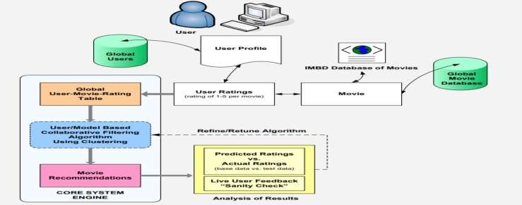
 |  | application and it will work locally acc. To the location you have specified Reusability: only one account for a particular user can be availed by the system at a time.
6. | STAKE HOLDER REQUIREMENTS | STRQ1. ADD the movies, series, games to be recommend STRQ2. Confirm the recommendation SRRQ3. Updating the recommendations in the app based on the user’s input STRQ4. Locating all the related movies, series or games based on the user’s recommendation. STRQ5. Android/iOS-based user interface. STRQ6. Security measures
7. | USER INTERFACE PRIORITIES | Professional look and feel Use of css3 for best animations and bootstrap Php used for encryption of password and connecting to Database The server used as local host is XMAPP server
8. | REPORTS/ GANTT CHART/FLOW DIAGRAM
9. | TEAM SIZE | 2

Slide 23

 |  | (19BCE1027-Aryaman Mishra,19BCE1575-Eshan Das)
10. | TECHNOLOGIES TO BE USED | HTML5, CSS3, PHP, JAVASCRIPT, JQUERY, MYSQL,ANDROID STUDIO.
11. | TOOLS TO BE USED | Sublime text for coding XAMPP server for local host PHP my admin to administer database
12. | FINAL DELIVERABLE MUST INCLUDE | Online or offline help to above said users. No mixing of recommendations and data security. No wrong recommendations of movies, series and games. Complete source code.
3. Version 1.2 approved
7. Introduction
1. Purpose
Movies, Series and Games recommendation system, is a software to look after the recommendation of movies, series and games to its users based on their friend’s recommendation. The app would give hands- on information(offline information which is updated from time-to-time by the developers in form of updates) and would be supported by databases containing information over 1000 entries in each section.
1. Document Conventions

Slide 24
Fonts : | Headings with font size are typed out in “Times” “18”.Bold style | The body for all sections is written in “Arial” with font size “11”. Italics style
Intended Audience and Reading Suggestions
As this software is developed in such a way that can be used by any kind of people who generally use internet, the end users are mainly the people who uses the internet browsers and watching entertainment shows and gaming.
Product Scope
The purpose of the Movies, Series and Games recommendation system is to ease to access the internet data’s anduser-friendly manner for the customers. The system is based on a relational database from medias, gaming’s and the entertainment shows. So the scope of this application is very widely distributed.
References
https://towardsdatascience.com/the-4-recommendation-engines-that-can-predict-your-movie- tastes-109dc4e10c52
https://www.manipalprolearn.com/blog/10-recommendation-engines-10-popular-brands-need- have
8. Overall Description
Product Perspective I/p-task-o/p
The objective of our project is to develop a software which will recommend the movies, series and games to its users based on their friend’s recommendation. We plan to create an app which runs on Android O which lets the users to create an account and a profile and tell others what film have they watched, which TV Showsare they watching or planned to watch and which Game have they been playing. The app would give hands-on information(offline information which is updated from time-to-time by the developers in form of updates) and would be supported by databases containing information over 1000 entries in each section.
Product Functions
It lets you to know what movie, game your friends have been watching and playing as recommendations
This lets you with the information’s(offline information’s which are getting updated

Slide 25



Information provided are of 3 categories include creators,availability,overview details and reception from various multimedia-related resources.
User Classes and Characteristics
As it is general software developed it can be used by any kind of people who generally use internet. The main characteristics is that the system needs to be updated every time do the information’s provide are latest and finest one.
Operating Environment
Operating environment for the Movies, Series and Games recommendation systemis as listed below.
Particulars | Client System | Server System
Operating System | Windows/Linux/Android/iOS | Linux
Processor | Intel or AMD | Intel or AMD
Hard Disk | 1 GB | 1 TB
RAM | 256 MB | 8 GB
Design and Implementation Constraints
Customers must give the details appropriately and also create a user credentials, so that the details passed and cross checked.
As this could be a bigger change in android app as it can include creators, availability,overview details and
reception from wide range of multimedia’s.
Constraints
The applicants require a computer to submit their information.
Although the security is given high importance, there is always a chance of intrusion in the web world which requires constant monitoring.
The user has to be careful while submitting the information. Much care is required.
User Documentation
a.https://towardsdatascience.com/the-4-recommendation-engines-that-can-predict-your- movie-tastes-109dc4e10c52

Slide 26

Assumptions and Dependencies
As this project was developed for people who uses internet for entertainment purpose, so people who use the online platform for gaming, series and movie watching purpose can utilize this app appropriately.
The Applicants and Administrator must have basic knowledge of computers and English Language.
The applicants may be required to scan the documents and send.
Each User must have a UserID and password
There must be an Administrator
Internet connection is a must
Proper browsers should be installed in the user’s system
9. External Interface Requirements
User Interfaces
Uses java(legacy programming language)
kotlin(new language introduce in 2017)
Hardware Interfaces
Operating system:windows, Linux,macOS
Hard disk :128Gb
RAM: 8Gb
Software Interfaces
Windows,Linux,macOS
Communications Interfaces
Window, and supported browsers

Slide 27

10. System Features
1. System Feature 1
Description and Priority
The objective of our project is to develop a software which will recommend the movies, series and games to its users based on their friend’s recommendation. We plan to create an app which runs on Android O which lets the users to create an account and a profile and tell others what film have they watched, which TV Shows are they watching or planned to watch and which Game have they been playing.The app would give hands-on information (offline information which is updated from time-to- time by the developers in form of updates) and would be supported by databases containing information over 1000 entries in each section.
Stimulus/Response Sequences
Input the details of the users: like the user credentials and the get the inputted the data’s in case of shows, series watched
4.1.3 Functional Requirements
FR1:Register
First the user will have to register/signup.and provide the datas(name,contact,email,DOB and credentials). The
manager will have to login for survey checks and updation by providing their register member ID and password.
FR2:Sign Up
Input: Details of users as mentioned in the description
Output: Confirmation of registration status and a membership number and password will be generated.
FR3:Login
Input: Enter the membership ID and password provided
Ouput: Users will be able to use the features of software
FR4:Find your movies,game and tv shows
Input: search for any multimedia titlee stated above.

Slide 28
Output: Entire page dedicated to the tilte with other functionalities.
FR5:Hands-on Details
Input: click on option from drop-down menu having director cast and release date output: command prompt gives required information
FR6:Search for other users
Input: search for friends by member id
output: view friends preffered multimedia choices.
FR7:Add to recommend/watchlists(including remove option) input: click on 'add to list'
output: movie/game/tv shows added to yor list under classification FR8: Update details of titles input: enter details of movies/games/shows output: confirmation of
addition
FR9. At the end when he wishes to exit the app, he would be asked to give his feedback and rate the application.
11. Other Nonfunctional Requirements
Performance Requirements
This project enables the user to view the recommended movies, series and games of their friends who have
watched and played.
Safety Requirements
Due to any catastrophic problem the database got damaged then by using the backup method and recover the data’s,so there will be additional database storage in hard-disk.
Security Requirements
Security system must be efficient like other application as this project stores sensitive data’s and a large database.

Slide 29

11.4 Software Quality Attributes
Portability: web services used so it can be ported.
Reliability : as the software is updated regularly, it is more reliable
11.5 Business Rules
As the information’s are not completely shared so it’s safer and more reliable for the users for
getting more useful data even without wasting time on searching.
Stakeholder requirements
STRQ 1: Users.
STRQ 2: Administrator/ Maintanence team.
Team size
2

Slide 30
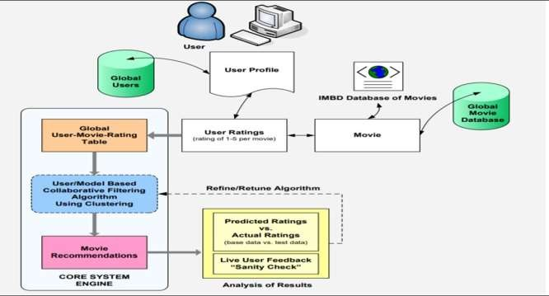
14. Report /Flow diagram/Gantt chart
Final Deliverable Must Include
Online or offline help to above said users. No mixing of recommendations and data security. No wrong recommendations of movies, series and games. Complete source code.
Other Requirements
This project can be used from any corners of the world as it is registered under a web services platform, as well as for running it there need a good storage.

Slide 31
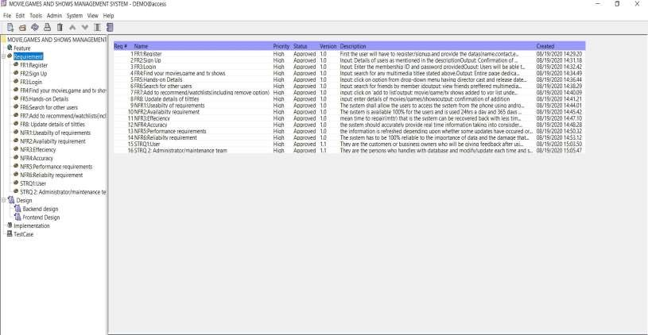
Requirement management of our project Movies, games and tv shows Management System using OSRMT.
4.
Functional requirements, non-functional requirements and stakeholders.

Slide 32
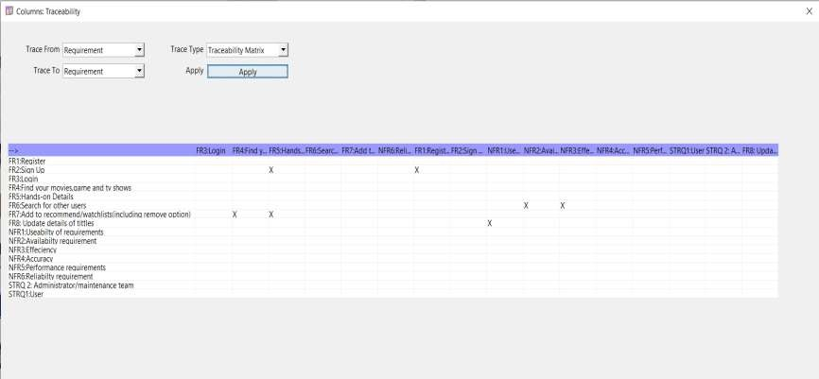
Traceability Matrix

Slide 33
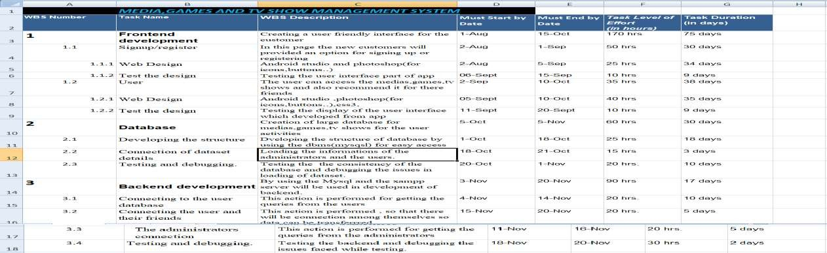
WBS - MEDIA,GAMES AND TV SHOW MANAGEMENT
SYSTEM
5.

Slide 34
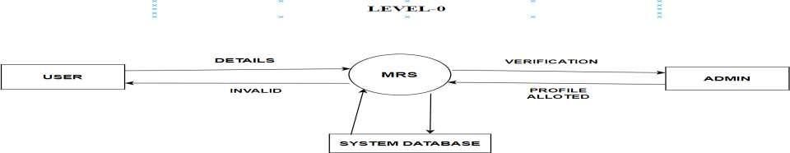
DATA FLOW DIAGRAM OF MEDIA,GAMES AND TV SHOW
MANAGEMENT SYSTEM
6.
LEVEL 0 - Context diagram

Slide 35
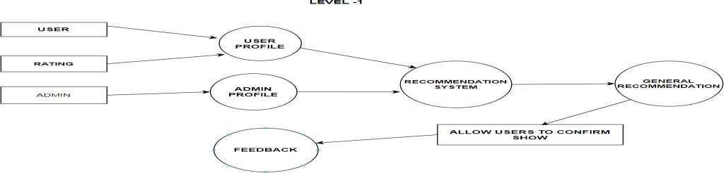
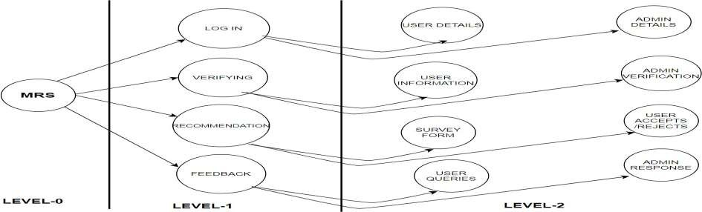
LEVEL 1–Data flow diagram
LEVEL 2 DFD

Slide 36
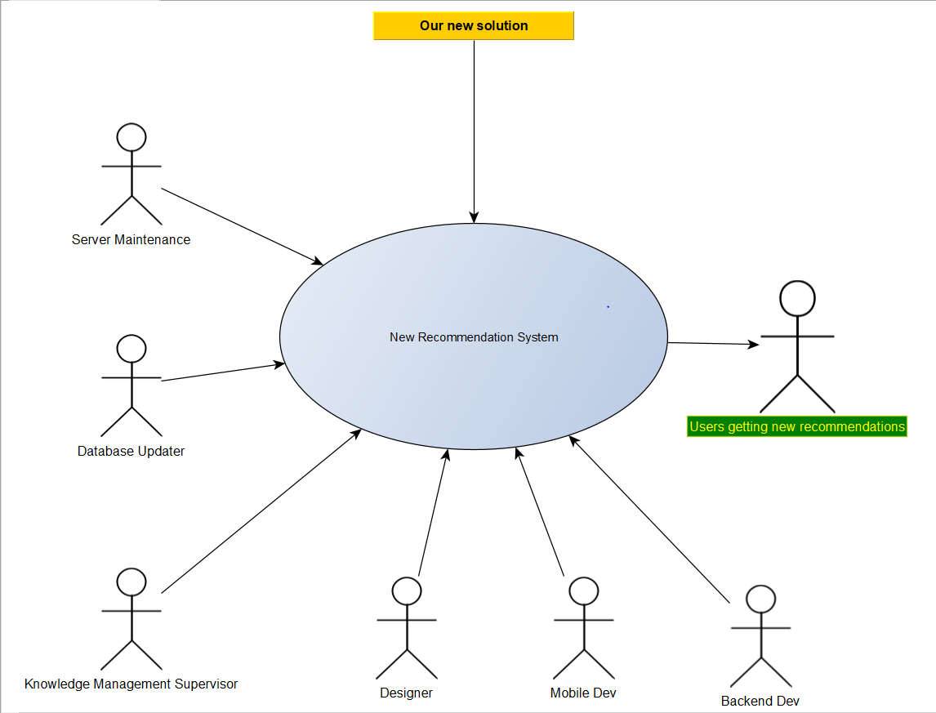

Slide 37
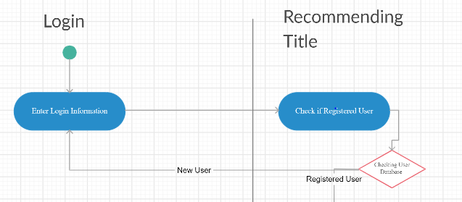
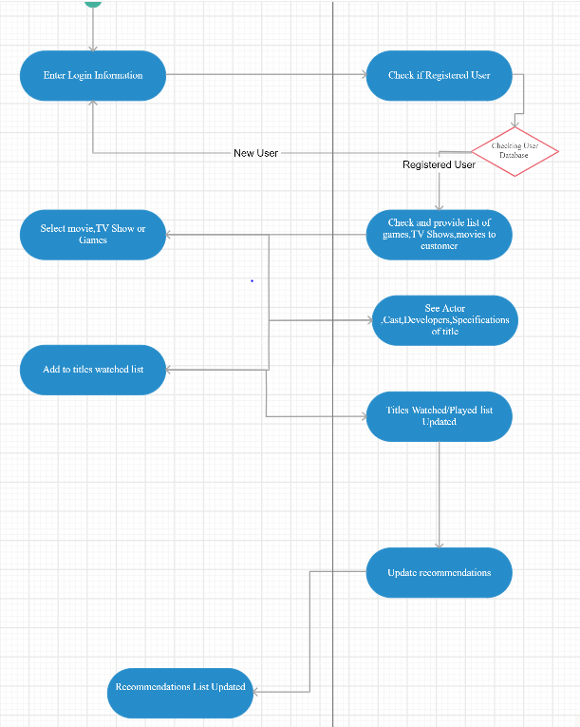

Slide 38
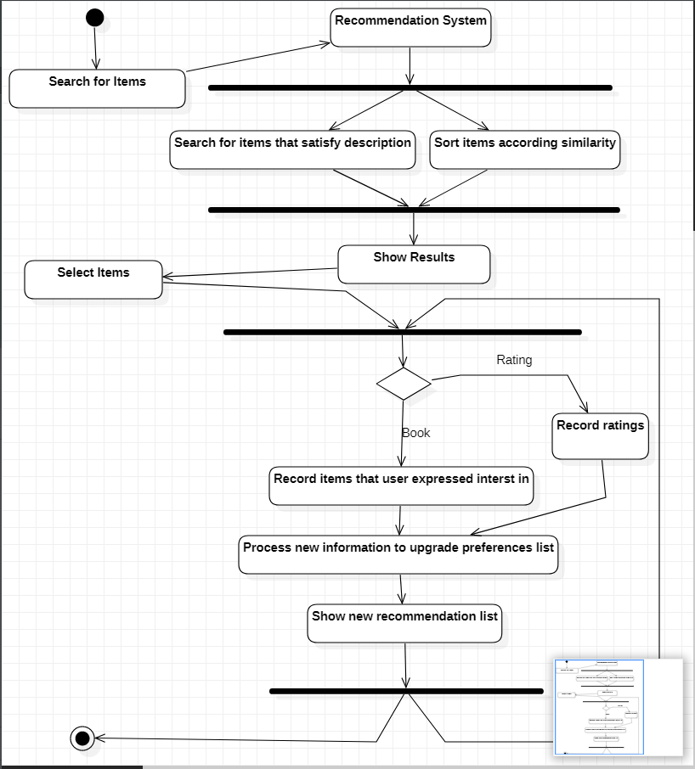

Slide 39
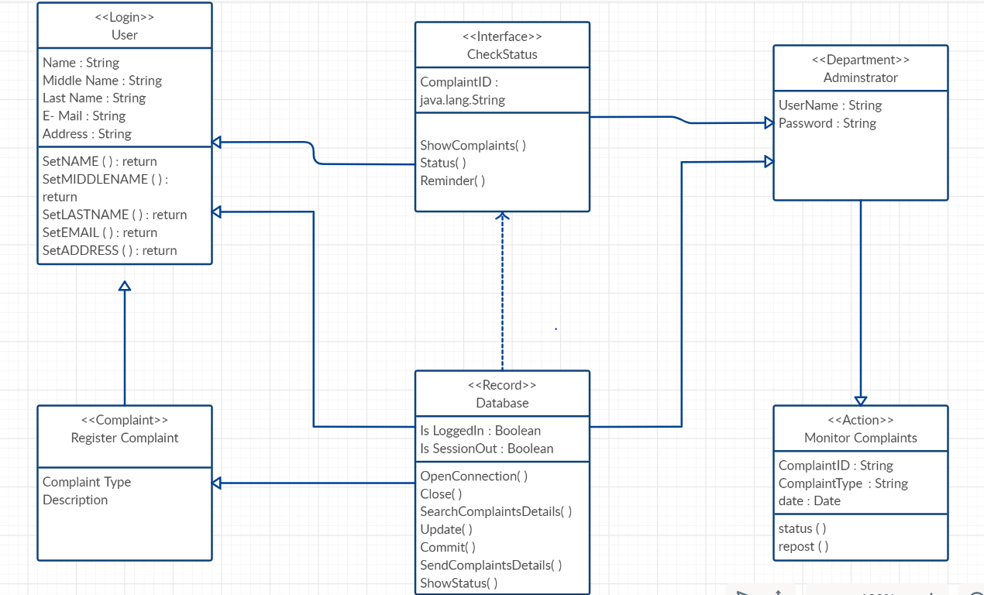

Slide 40
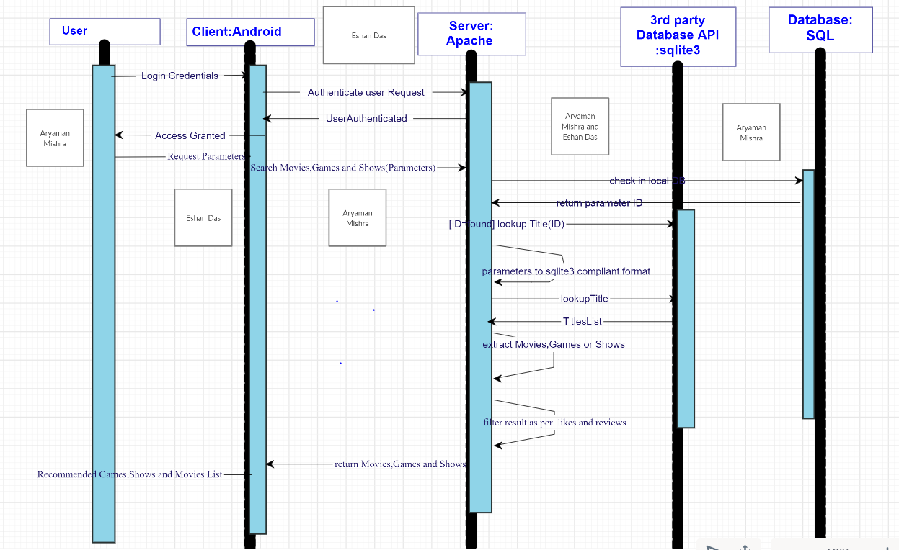

Slide 41
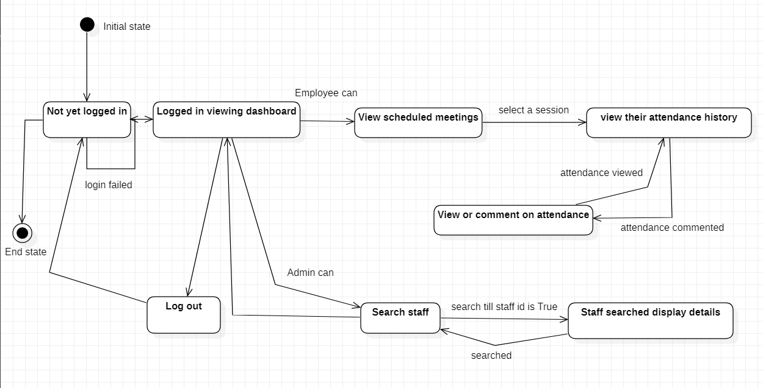

Slide 42
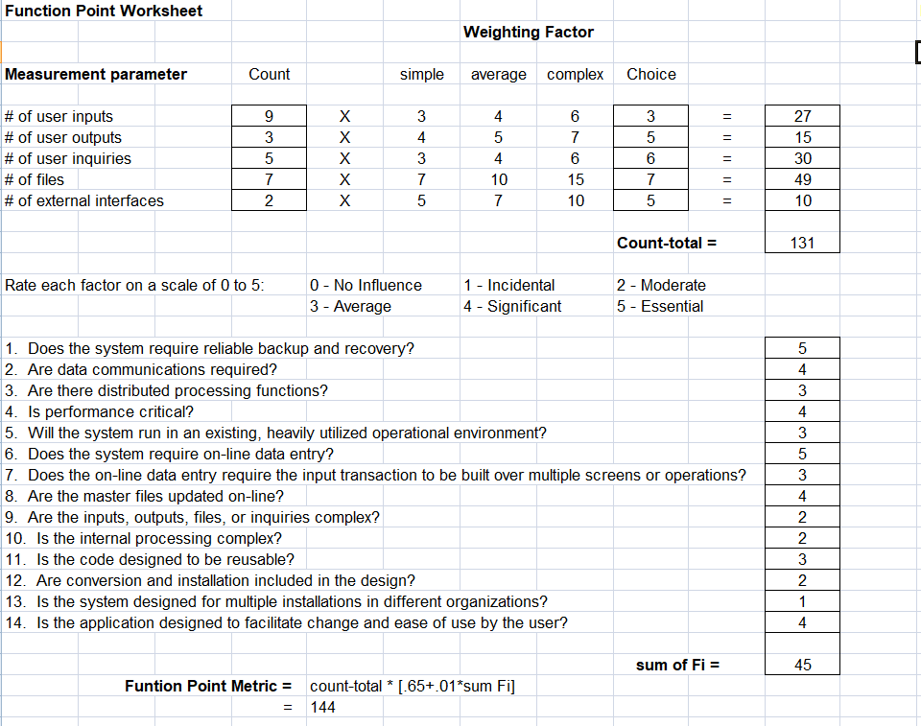

Slide 43
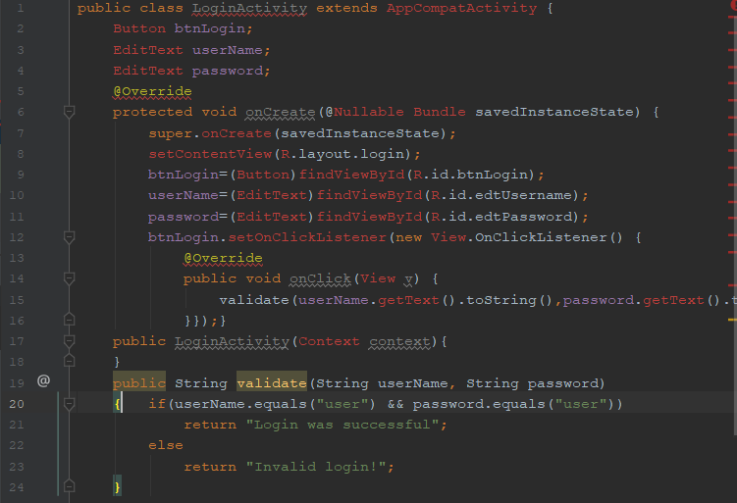
(Two test suites for the project Login and Signup using J-UNIT)

Slide 44
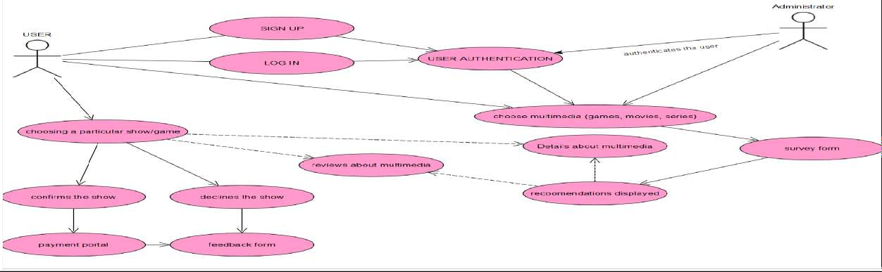
7.
UML_Usecase—BASIC
Use Case Diagram:
ACTORS:
User of the app/website
Administrator of the app/website

Slide 45

USE CASES
Use case: Sign up
The user who have entered the website/app for the first time (new users) have to
register to the website for the first time so that every other time they come to the website they can continue from where they left.
Use case: Log In
The user who are not coming for the first time and who already have their user id can login and continue the page rom where they left off.
Use case: UserAuthentication
The administrator will authenticate the details provided by the user by verifying the email and phone number of the user and saving it in database.
Use case: Choosing Multimedia
The administrator will ask the user to choose the type of multimedia from the options provided for movies, games or shows. The user cannot choose more than 1 option at a time.
Use case: Survey Form
In this port the user can fill the details so that the admin can sort the results accordingly and will help for the recommendation become more easier.

Slide 46
Use case: Choosing A Particular Show
The user will choose a particular show out of the recommendations provided to
them based on the survey form they filled.
Use case: Details about multimedia
The user will be able to see the information about the movies/series/games they choose like the director, producer, casts of the show.
Use case: Reviews About Multimedia
The user will also be able to see the review of that movie/series given by their friends
and other users of the app
Use case: Confirms/Declines The Show
After reading the reviews about the show the user will be asked to either confirm the show if he wants to see the show or he wants to decline the show and go for any other recommendation.
Use case: Payment Portal
Once the user confirms the show the user will be send to the payment portal to continue the payment for the show/game he has confirmed.
Use case: Feedback From
At the end of the user’s activity the administrator will be asked
to fill the feedback from about his/her experience of the

Slide 47

app/website and their suggestions would be taken into consideration.
Use case detailed Description Use case: Survey Form
In this port the user can fill the details so that the admin can sort the results
accordingly and will help for the recommendation become more easier.
Precondition: To fill the survey form the user must first select the type of multimedia (movies, series, games) related to which the survey form would be asked to be filled by the user.
Post condition: After filling the survey form the administrator will sort the results
accordingly and the recommendations must be displayed.
Use case: Choosing Multimedia
The administrator will ask the user to choose the type of multimedia from the options provided for movies, games or shows. The user cannot choose more than 1 option at a time.
Precondition: For this the user need to be registered and login.
Post condition: after the registering and logging- in the user can choose the multimedia’s such as movie, series and games for watching and playing.

Slide 48
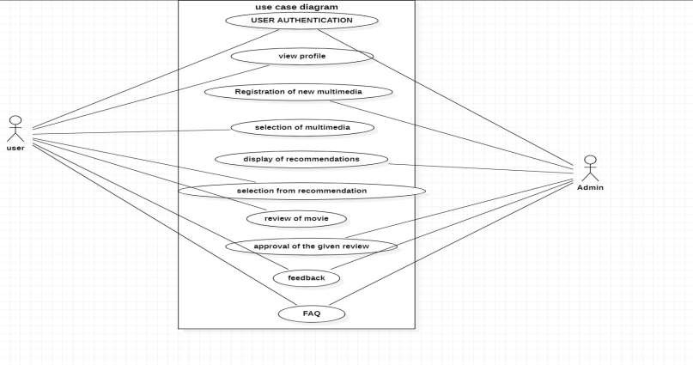
7.1
Use case diagram advanced
Use case diagram (version 1.2)

Slide 49

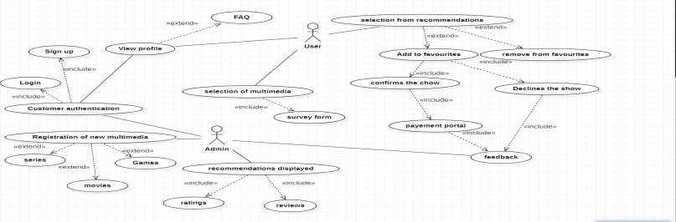
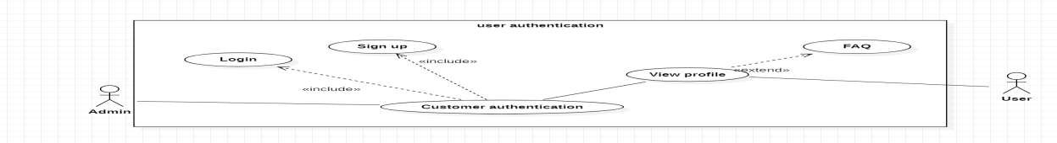
Sub Use Cases:
Description of 3 Main use cases and their sub use cases: 1.
Registration of new user:

Slide 50
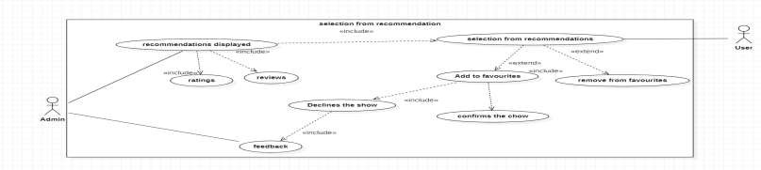
Description: The users who are new to this application and they wish to register must create their login. For creating the login, the user will have to upload some of his details. They can refer the FAQ section for more details. Admin is the person who will be verifying the details uploaded by the user and then will either grant the permission of the login creation or will reject it.
Requirements: The user must accept all the terms and conditions and also must give his/her correct personal information in order to access the app. The user should also have internet facility and basic knowledge of computer.
2. Selection from recommendation given by admin:
Description: Based on the survey form filled by the user, the admin will display some recommendations which would consist of ratings and reviews, from the given recommendation the user will select the show and will shortlist them by adding them to favourites.

Slide 51
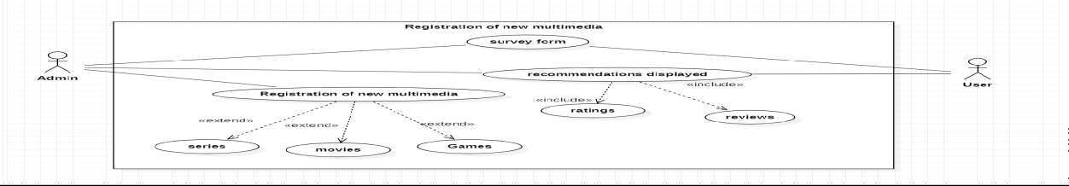
3. Registration of new multimedia:
Requirements: in order to see the recommendation, the user must fill the survey form given by the admin and in order to give ratings to any particular show he must have watched that show. Without watching the user can’t rate the show.
Description: If the admin finds any new multimedia (movies/ series/ games) from the survey form filled by the user, the admin can include them into the database and then display them in recommendations.
Requirements: To add any new multimedia into the database the admin must have its proper information like its producer, its genre, ratings of the show/games, and its review. If the admin doesn’t have all this information, the show can’t be added the database

Slide 52

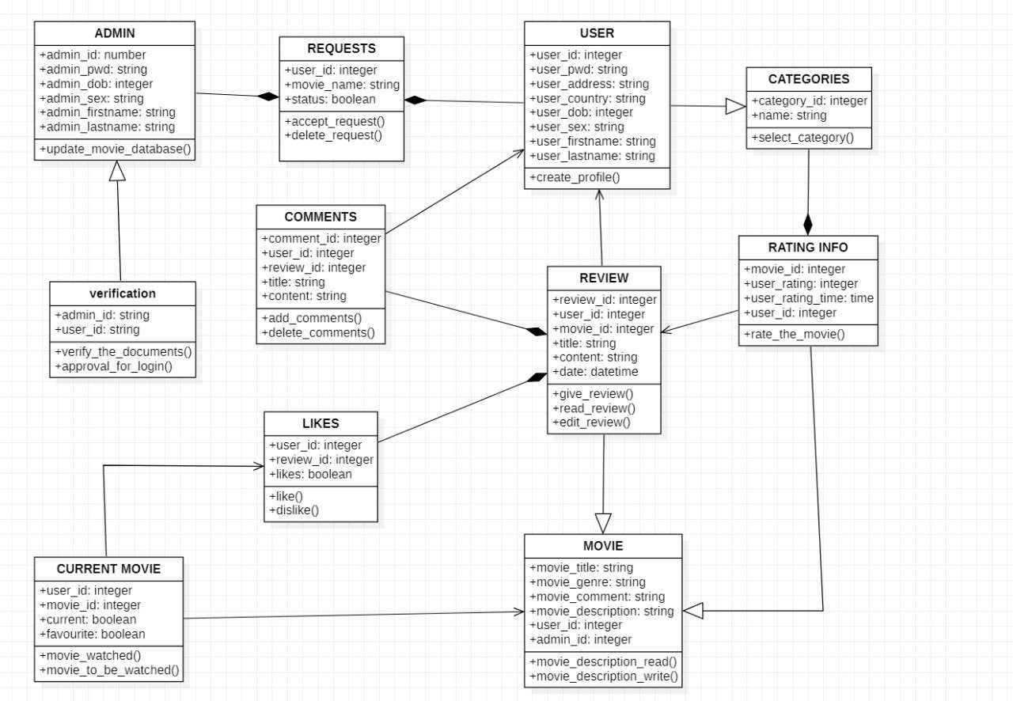
Class diagram:

Slide 53

Page layouts:
1. Splash screen

Slide 54


Page layouts:
2. Login screen

Slide 55

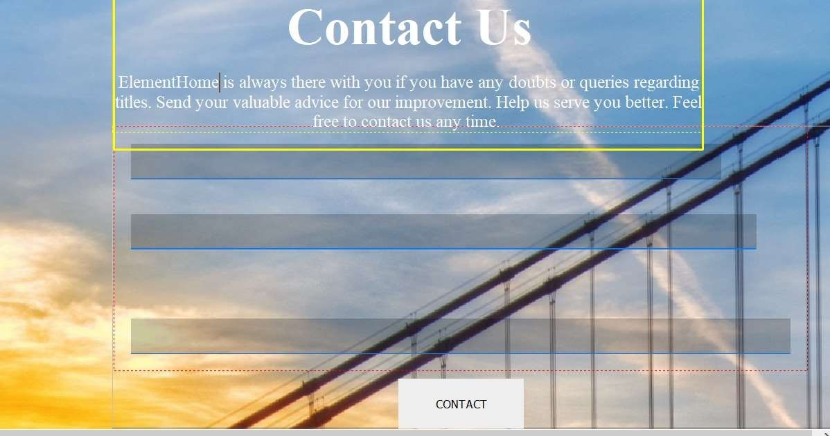
Page layouts:
3. Outro/end screen

Slide 56
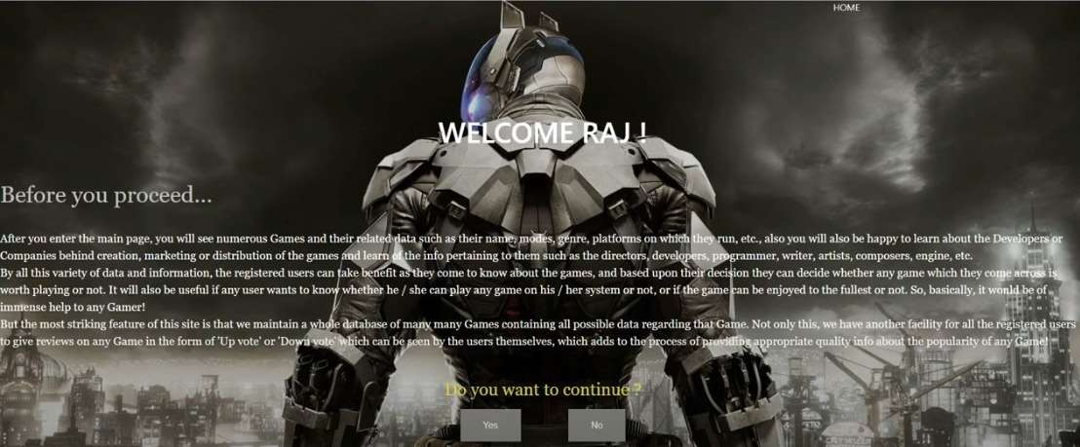
Page layouts:
4. Introduction screen

Slide 57
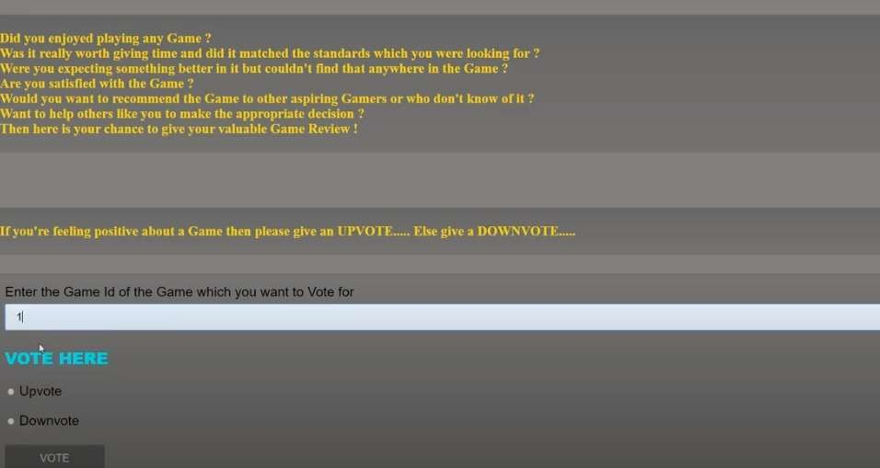
Page layouts:
5. Review screen

Slide 58
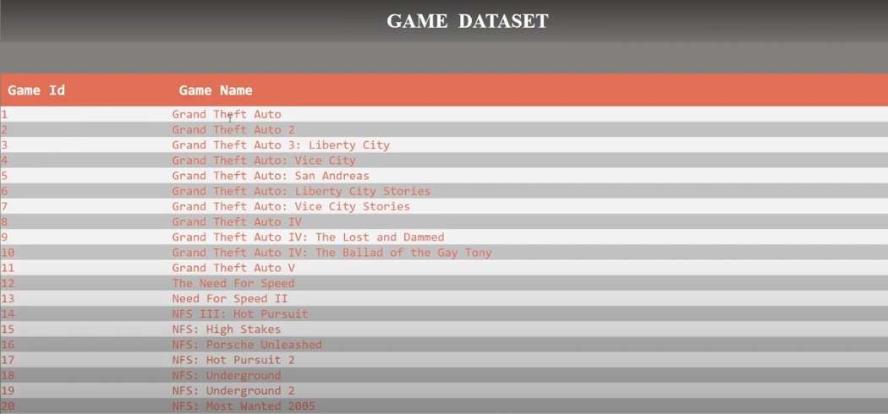
Page layouts:
6. recommendations screen

Slide 59

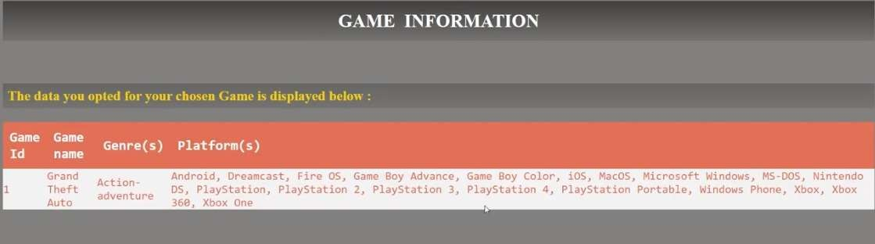
Page layouts:
7. Selection from recommendation screen

Slide 60
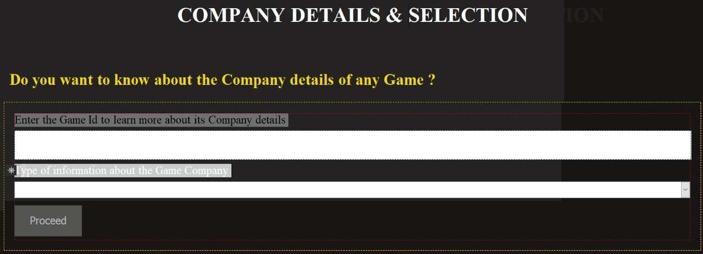
Page layouts:
8. Information about a particular selected game:

Slide 61

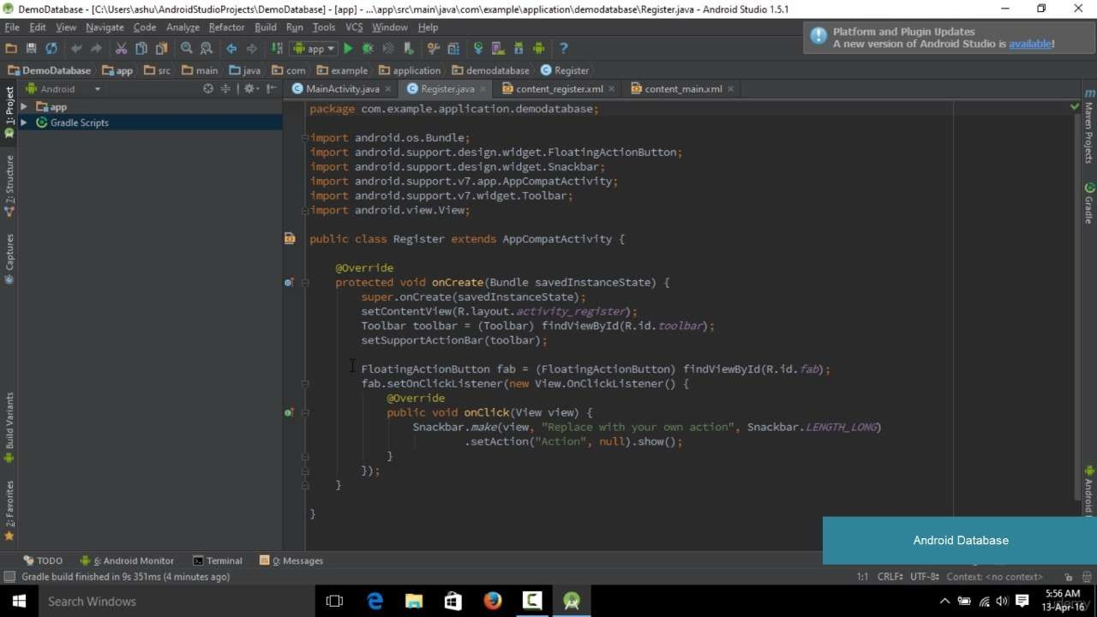
IMPLEMENTATIONS:

Slide 62
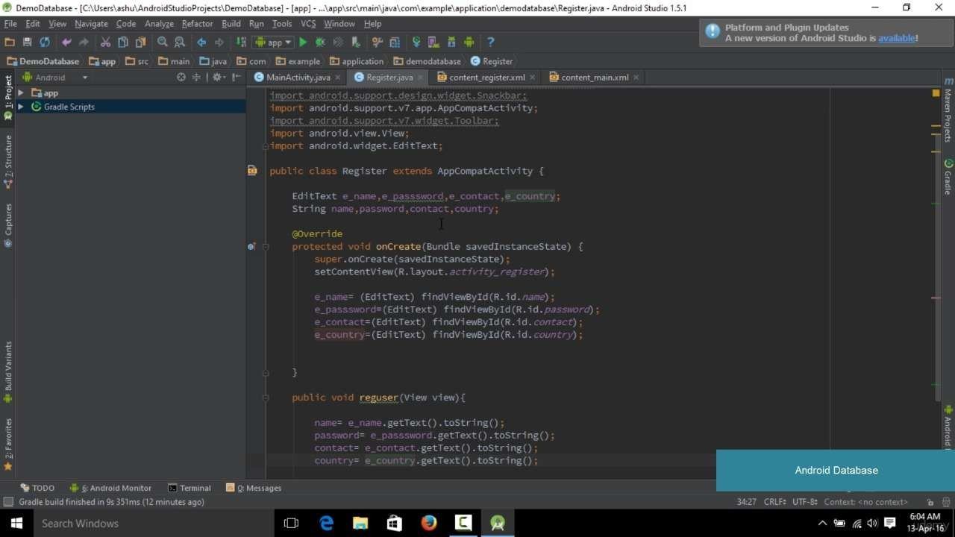
IMPLEMENTATIONS:

Slide 63
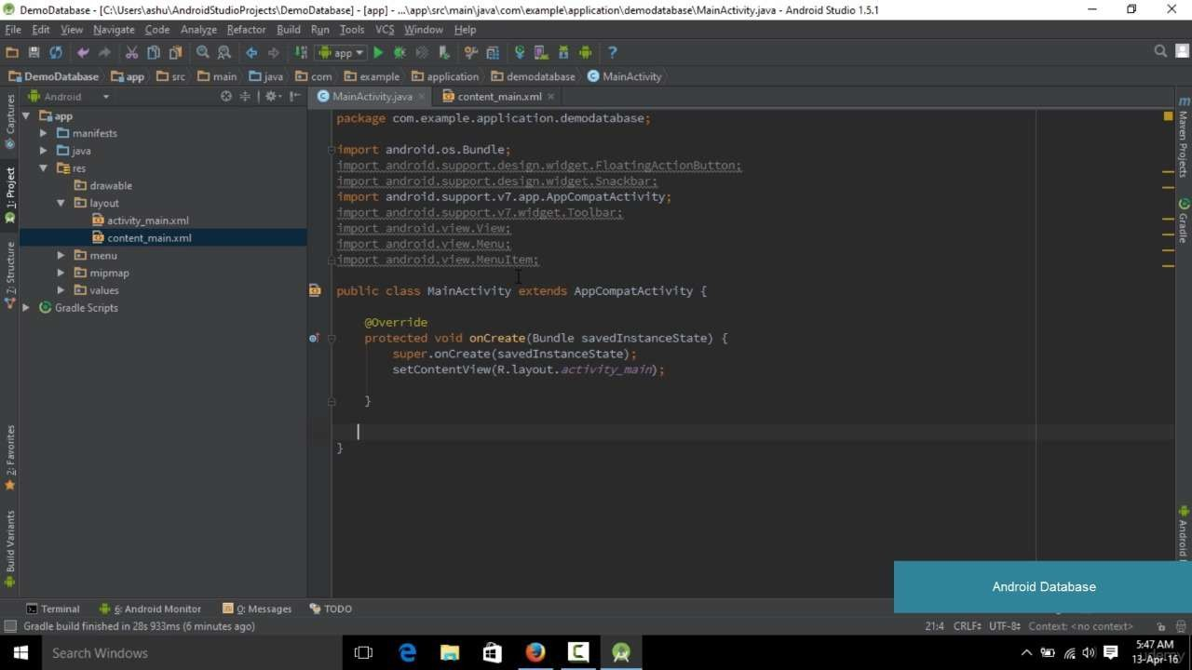
IMPLEMENTATIONS:

